Slide 1
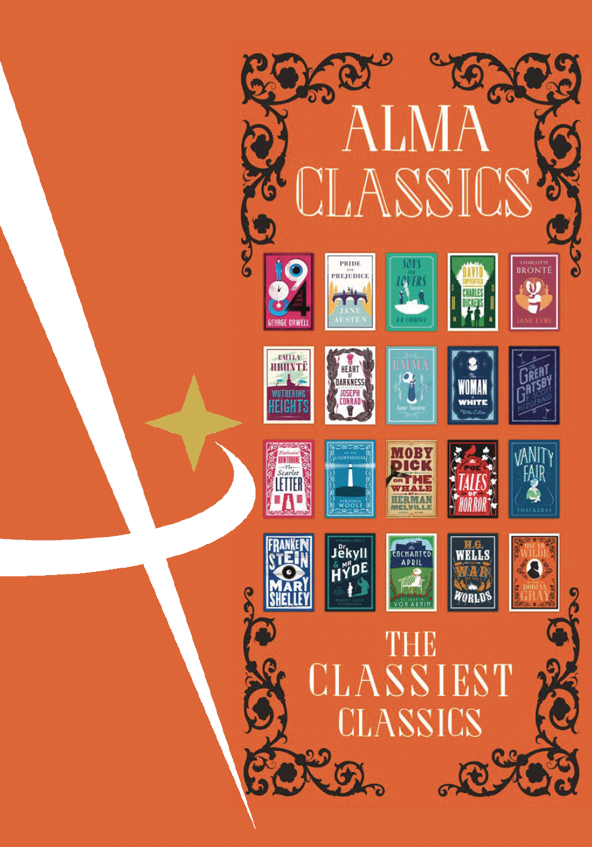


EVERGREENS
FORTHCOMING TITLES JULY TO DEC 2022

Slide 2
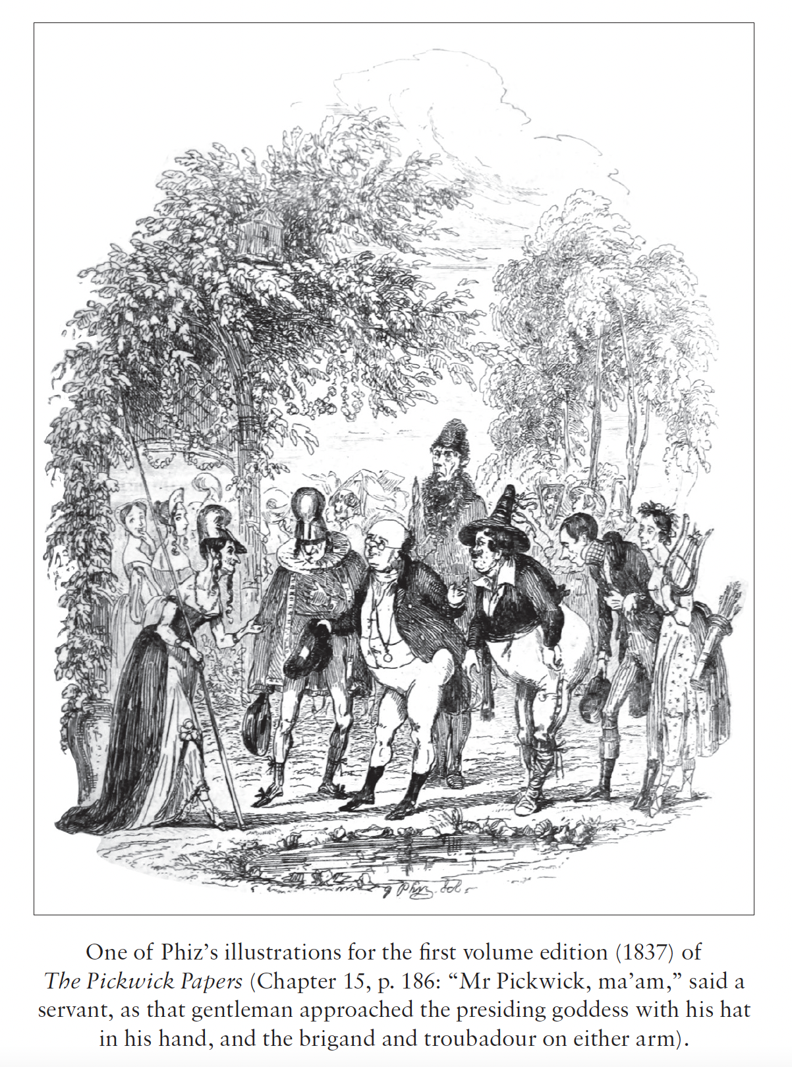
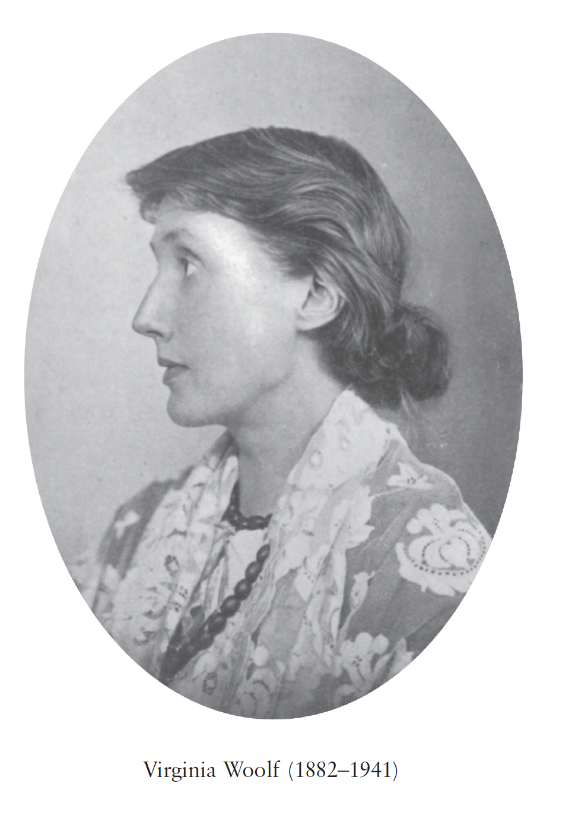
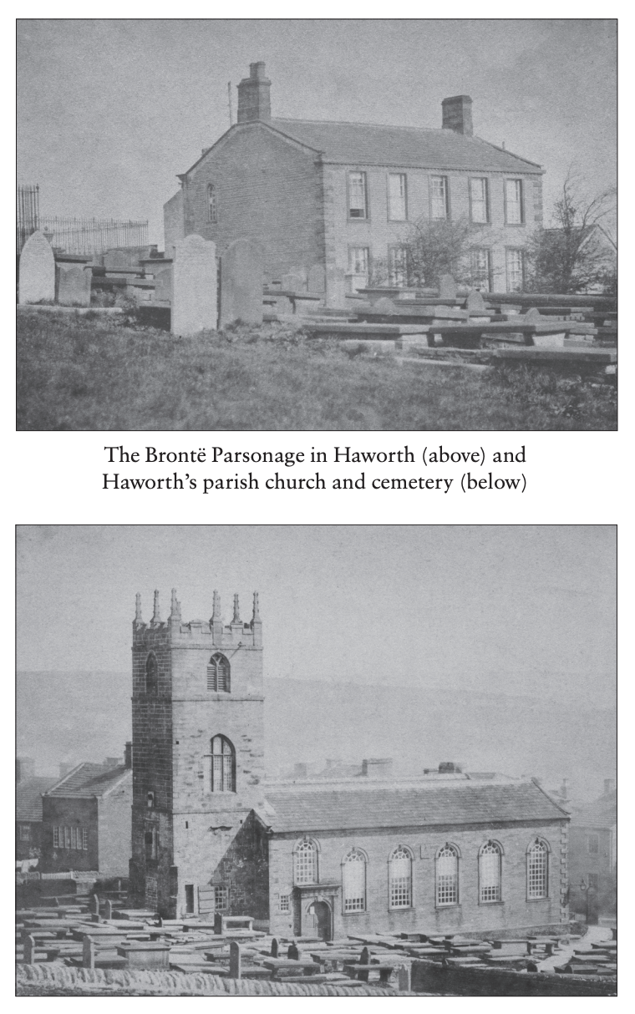
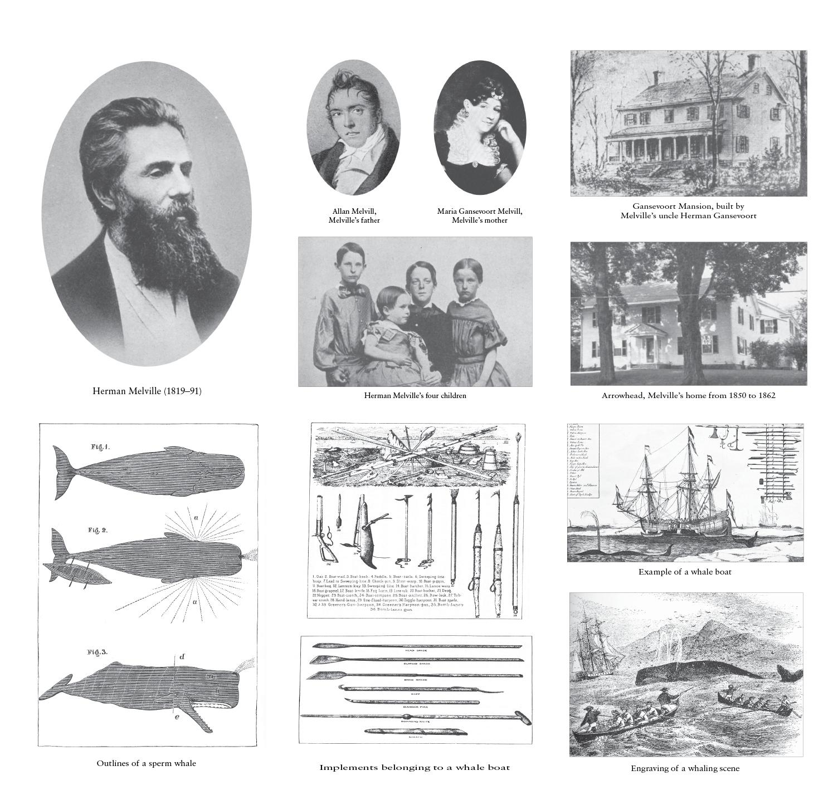
ABOUT THE SERIES: Alma Classics Evergreens is a series of popular classics. All the titles in the series are provided with:
ILLUSTRATIONS:
Eight plates with pictures, photos and drawings which brings the past to life for the modern reader. Images of people, places, manuscripts and more give a unique visual insight into the world in which the book was written.
ATHOR’S LIFE
A section concentrating on the personal and historical circumstances that shaped the author’s work.
AUTHOR’S LITERARY CAREER
A list of the author’s works in chronological order, accompanied by brief descriptions and commentaries, with in-depth accounts of the major works and the title in question.
TEXT AND TRANSLATOR’S NOTES
A short textual note and, if relevant, a brief translation note and translator’s biography.
BIBLIOGRAPHY
A list of bibliographical resources to guide further reading.
ESSENTIAL NOTES
These will provide important contextual detail relevant to the work
APPENDICES
Further reading material, such as relevant letters, documents or works by the author.
EVERGREENS
Over 100 titles

Slide 3
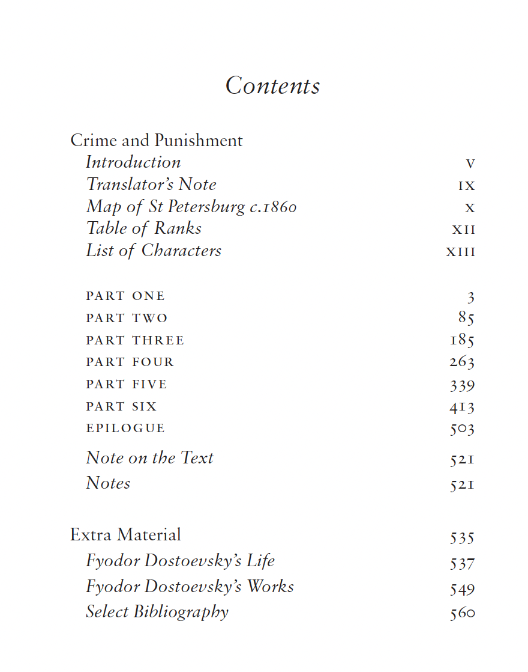
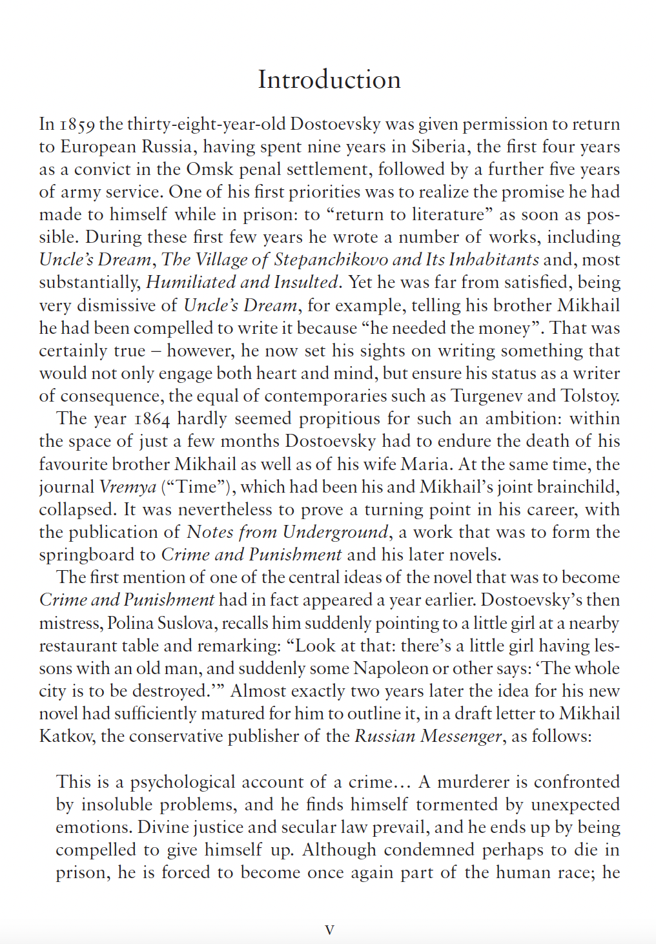
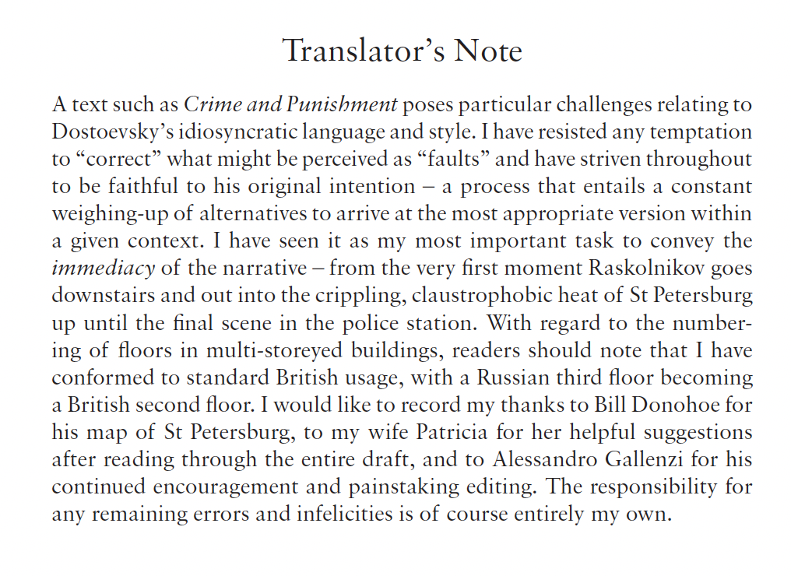
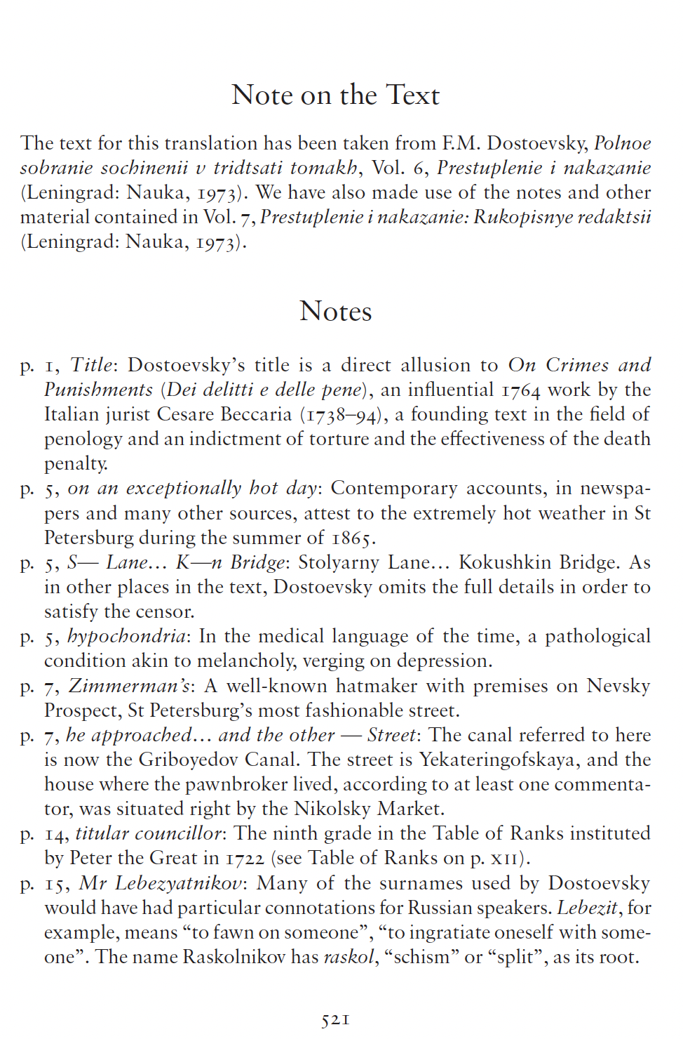
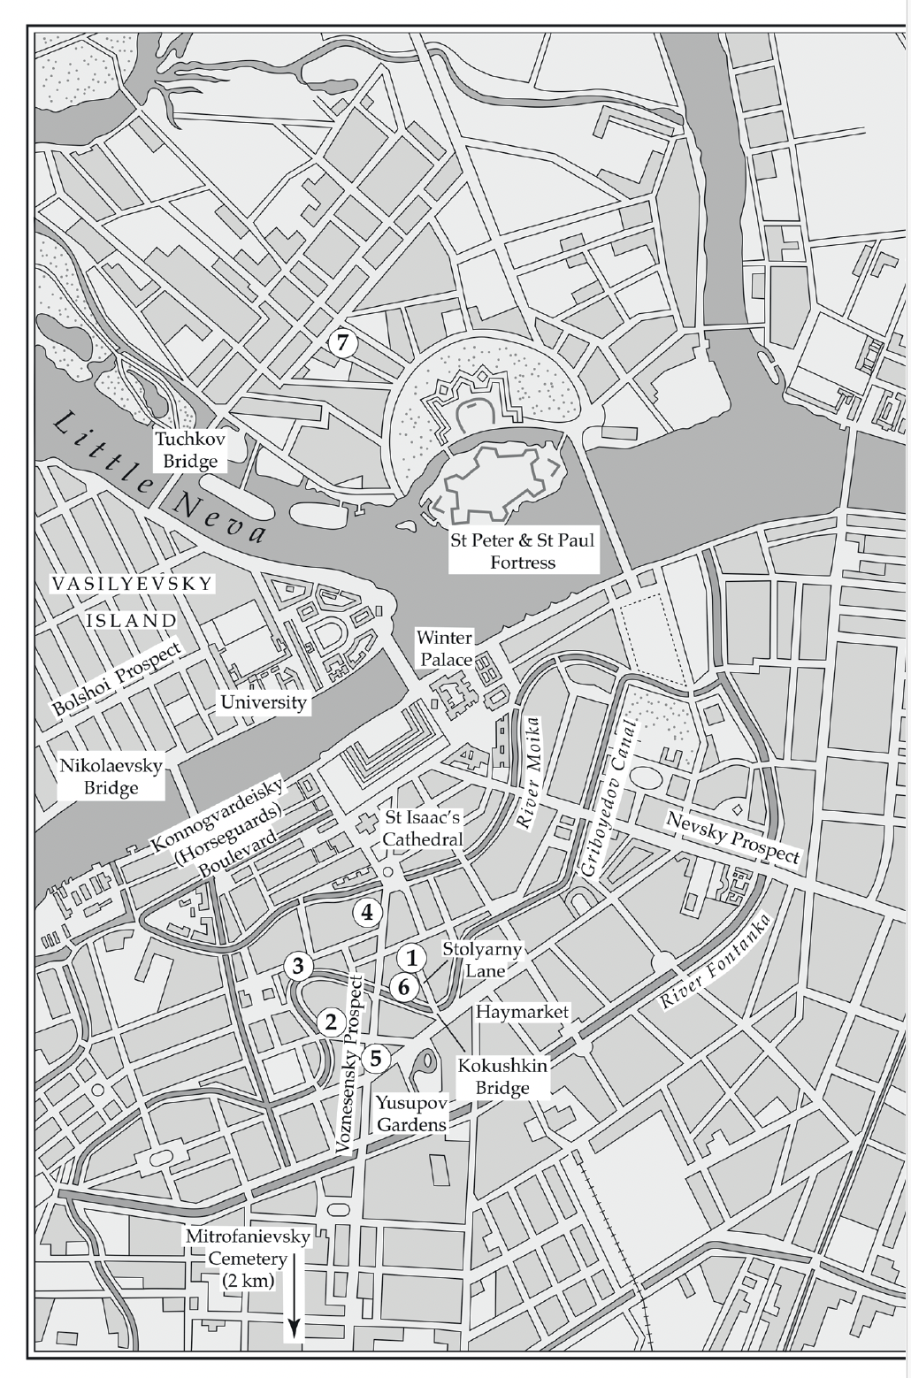
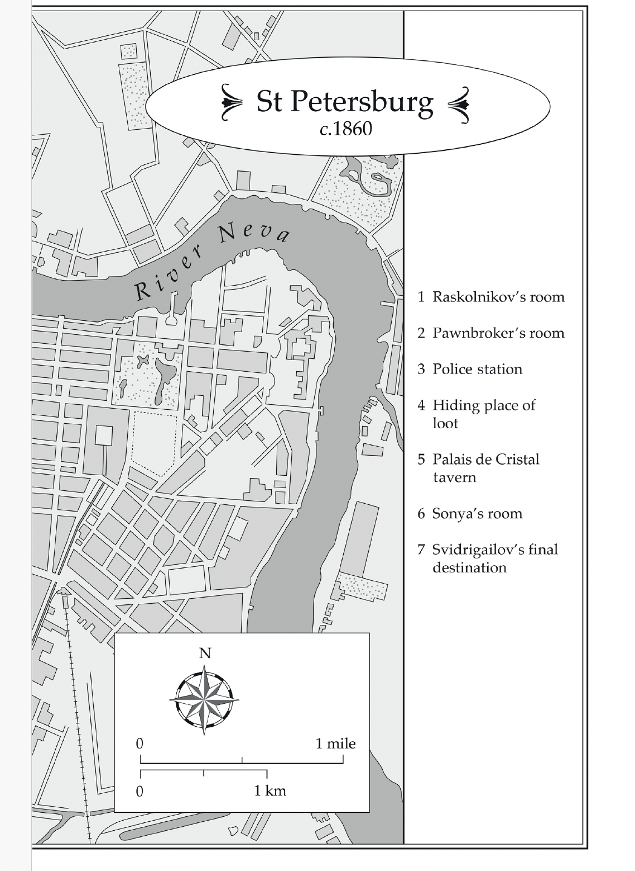
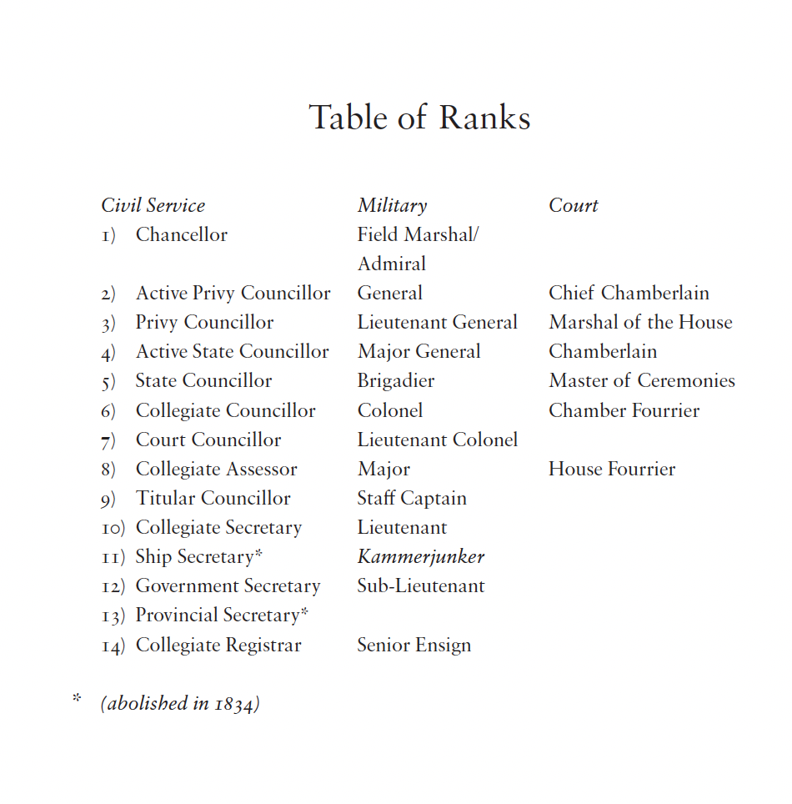
SAMPLE PAGES FROM CRIME AND PUNISHMENT BY FYODOR DOSTOEVSKY

Slide 4



WAR AND PEACE
NEW CLASSIC – APRIL 2027
BY LEO TOLSTOY
NEW TRANSLATION BY
STEPHEN PIMENOFF
New translation of War and Peace by Leo Tolstoy
Translated by critically acclaimed translator Stephen Pimenoff
Presented in a fully annotated deluxe edition
Contains a preface, a translator’s note, an extensive critical apparatus, and extra reading material, including a section of photographs and notes
SERIES: Alma Classics
22nd April 2027
£25
9781847499530
Demi Hardback
1200 pp
Subject: FBC, FYT
Rights: World English
Printed straight onto the hardback boards
using foil blocked case
sprayed edges, printed endpapers and ribbon
ISBN 978-1-84749-826-7
PAPERBACK – 288 pp.
£5.99

Slide 5

WAR AND PEACE
NEW EVERGREENS – APRIL 2027
BY LEO TOLSTOY
New translation by Stephen Pimenoff
New translation of War and Peace by Leo Tolstoy
Annotated edition with over 2,000 notes
Remains faithful to the original and brings all of Tolstoy’s wit to life
Completes the Tolstoy Collection (all 9 volumes in the collection are presented in new translations)
Part of Alma Evergreens, a series of popular classics
SERIES: Alma Classics
Evergreens
22nd April 2027
£12.99
9781847499509
1200 pp • PB
Subject: FBC, FYT
Rights: World English
ISBN 978-1-84749-826-7
PAPERBACK – 288 pp.
£5.99

Slide 6

Anna Karenina
9781847493682 £7.99
A Calendar of Wisdom
9781847495631 £8.99
Childhood, Boyhood, Youth
9781847496003 £8.99
The Death of Ivan Ilyich and The Devil
9781847493637 £8.99
The Forged Coupon
9781847496676 £8.99
Hadji Murat
9781847494818 £8.99
The Kreutzer Sonata and Other Stories
9781847494115 £8.99
Three Novellas:
The Devil, Family Happiness and A Landowner’s Morning
9781847494795 £8.99
– All books are presented in new translations
– Contain notes and extra material
– The most complete collection of works by
Leo Tolstoy on the market

Slide 7

TORRENTS OF SPRING
NEW ALMA CLASSICS – MAY 2027
BY IVAN TURGENEV
New translation by Michael Pursglove
New translation of a novella about memory, moral weakness and love
Annotated edition
Completes the Ivan Turgenev Collection (all 11 volumes in the collection are presented in new translations)
SERIES: Alma Classics
26th May 2027
£9.99
9781847499462
288 pp • PB
Subject: FBC, FYT
Rights: World English
ISBN 978-1-84749-826-7
PAPERBACK – 288 pp.
£5.99

Slide 8

A Nest of the Gentry
9781847495907 £8.99
Fathers and Children
9781847494894 £7.99
Faust
9781847492180 £9.99
Memoirs of a Hunter
9781847499042 £9.99
On the Eve
9781847496324 £8.99
Hadji Murat
9781847494818 £8.99
Parasha and Other Poems
9781847498915 £8.99
Rudin
9781847492265 £8.99
Smoke
9781847493163 £8.99
The Diary of a Superfluous Man and Other Novellas
9781847497628 £8.99
Virgin Soil
9781847493750 £8.99
– All books are presented in new translations
– Contain notes and extra material
– The most complete collection of works by Ivan Turgenev on the
market

Slide 9




VILLETTE
NEW EVERGREENS – JUNE 2027
CHARLOTTE BRONTË
New annotated edition of Charlotte Brontë’s masterpiece
Contains notes, a bibliography and extra material
New addition to Alma Evergreens, a series of popular classics
Perfect companion volume to Jane Eyre 9781847493736, The Green Dwarf and Other Early Fiction 9781847497611 and The Professor 9781847497178
24th June 2027
£9.99
9781847499431
500 pp • PB
Subject: FBC, FXD
Rights: World English
ISBN 978-1-84749-825-0
PAPERBACK – 224 pp.
£5.99

Slide 10
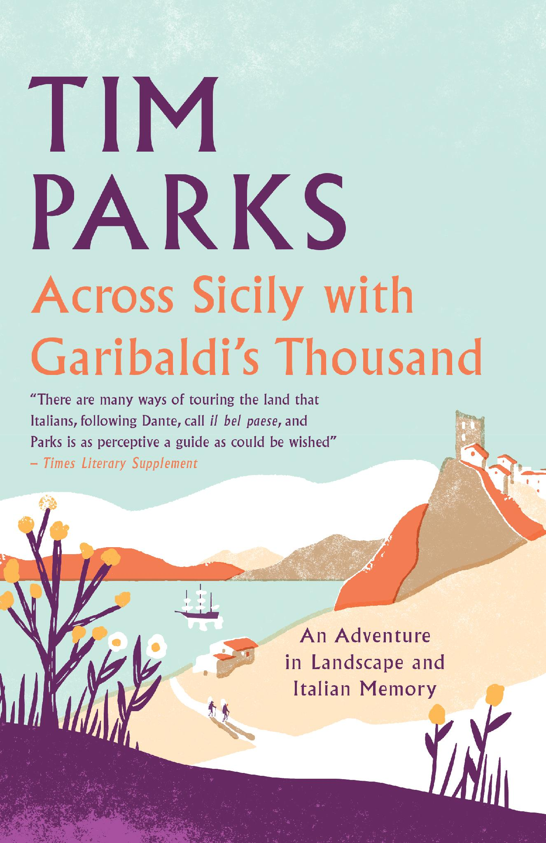
Now in Paperback
ACROSS SICILY GARIBALDI’S THOUSAND
BY TIM PARKS
• Tim Parks’s delightful account in Garibaldi's footsteps, now in paperback
• Well researched and full of extracts from diaries and letters written by men on both sides of the political divide
• A perfect blend between historical account and travelogue, past and present
Parks has done Garibaldi and his Redshirts proud in this eccentric hosannah to the travails of walking in the Sicilian uplands.’ Ian Thomson, The Spectator
The many diaries written by those who accompanied Garibaldi are skilfully blended with the author’s own story.’ Times Literary Supplement
There’s an admirable stubbornness also in the writer’s quiet demand for answers about the authentic relationship between present and past in Italy. A feeling that serene indifference isn’t enough lends distinction to this book.’ Literary Review
SERIES: Alma Books / Non-fiction
26th May 2027
£12.99
9781846884771
320 pp • Paperback
Subject: WTL, 3MNQ-IT-N
Rights: World English
ISBN 978-1-84749-828-1
PAPERBACK – 224 pp.
£5.99

Slide 11

GREAT LOVE STORIES IN ALMA CLASSICS

Slide 12

EVERGREENS
FORTHCOMING TITLES JULY TO DEC 2022

Slide 13











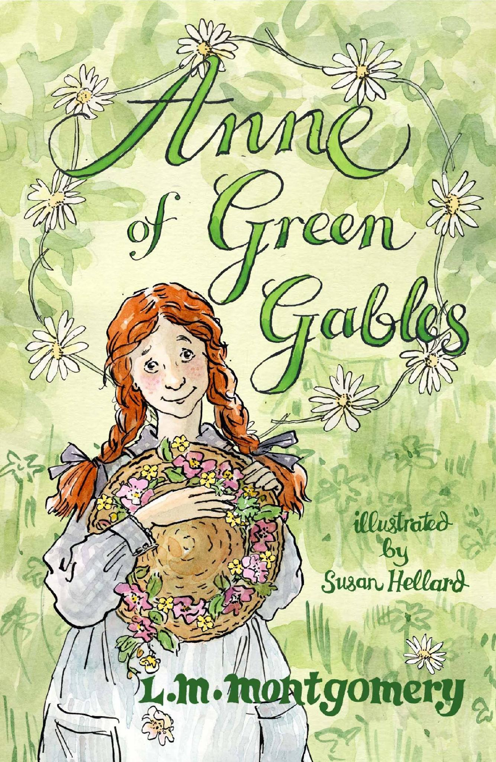

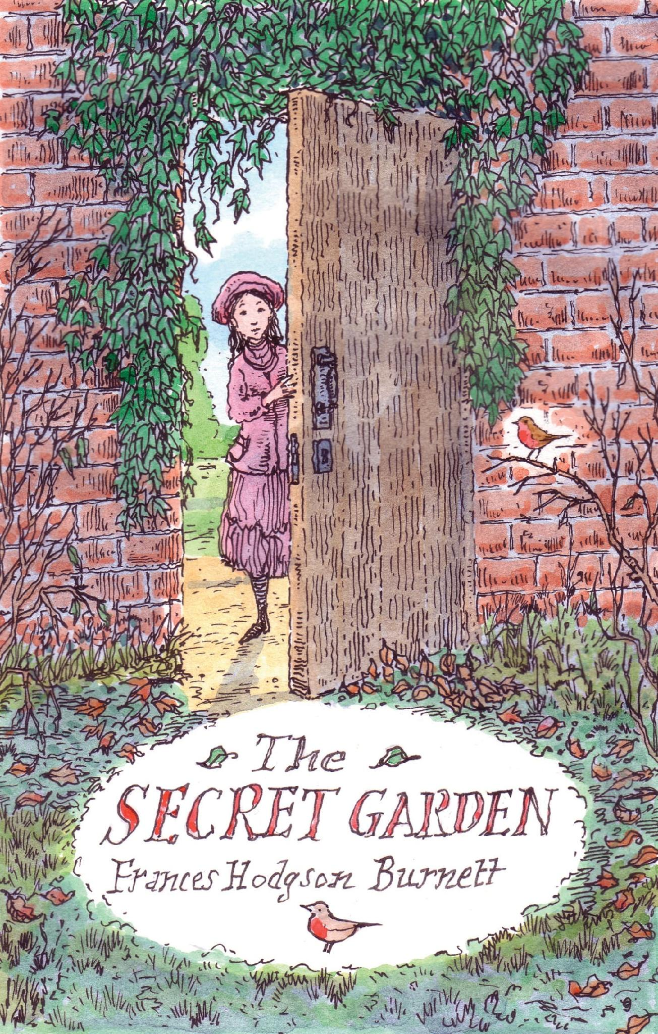
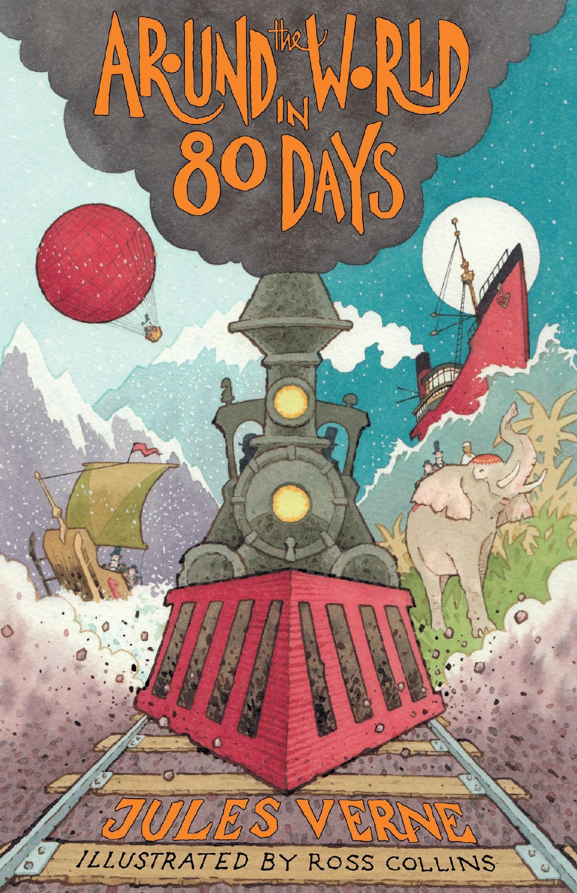


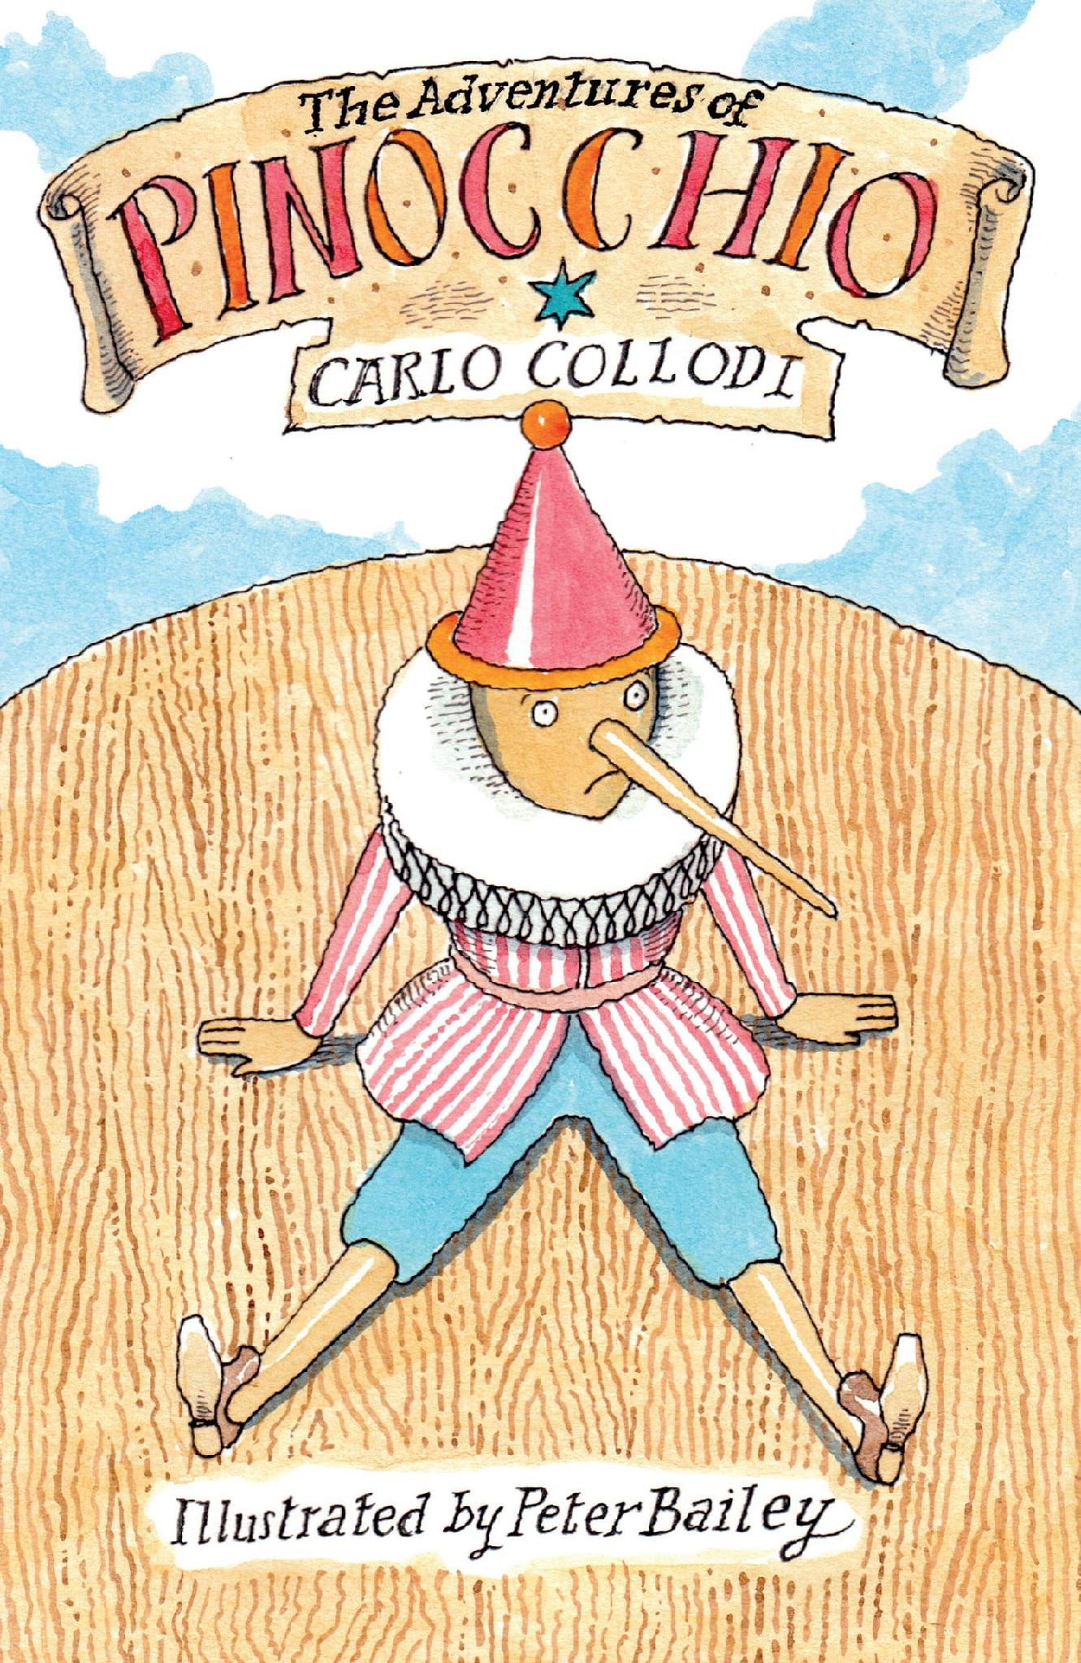



• All our children’s classics have beautiful drawings by renowned illustrators
• Each volume contains extra material for young readers, including:
a profile of the author
a section about the book
a list of characters
a glossary
a test-yourself quiz
EVERGREENS
FORTHCOMING TITLES JULY TO DEC 2022
ALMA JUNIOR TOP 20

Slide 14



• All our classics offer students the definitive text and extensive notes
• All our editions contain detailed and
comprehensive extra material about the author’s life and works
• Each volume contains a carefully selected bibliography
• Accurate translations
• All our books are presented in beautiful paperback editions and are accessibly priced
ALMA CLASSICS TOP 20

Slide 15
