Slide 1



EVERGREENS
FORTHCOMING TITLES July to Dec 2022

Slide 2
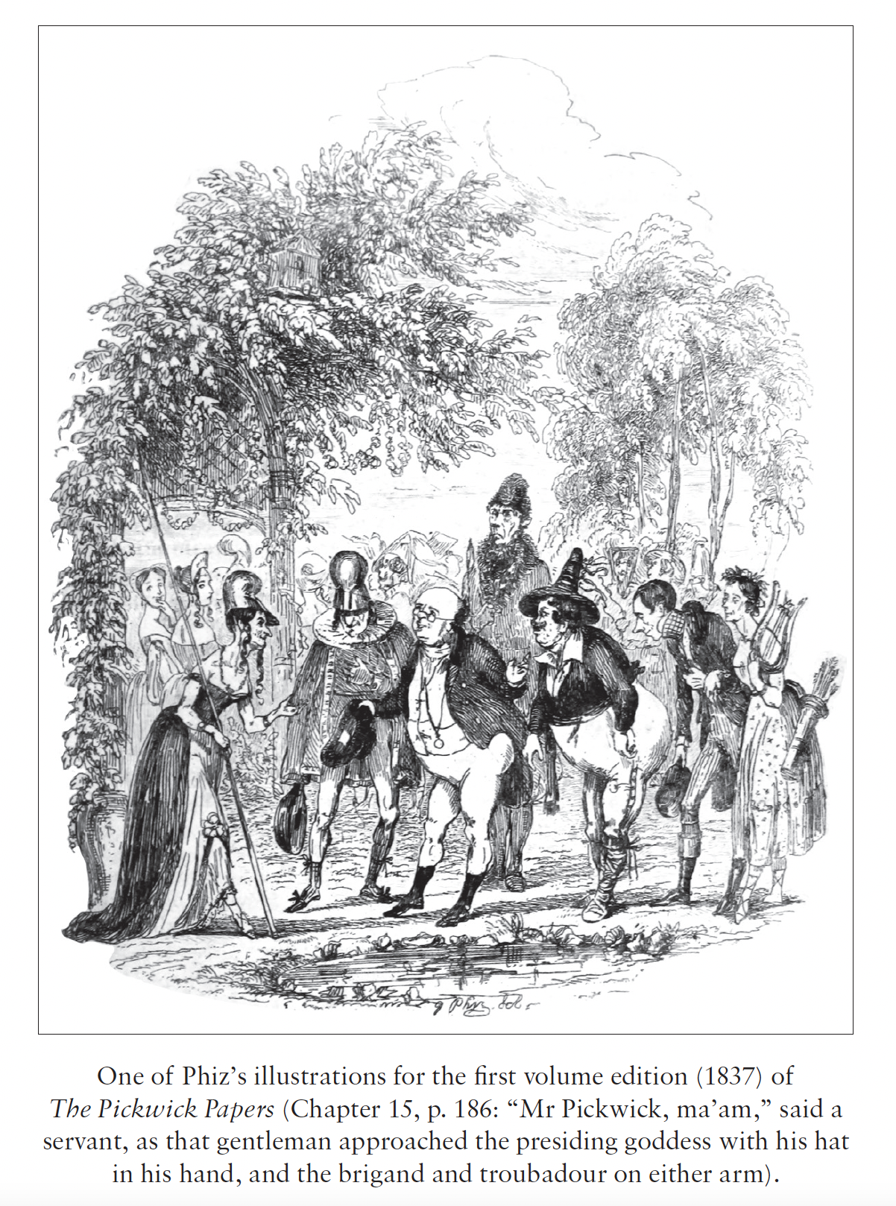
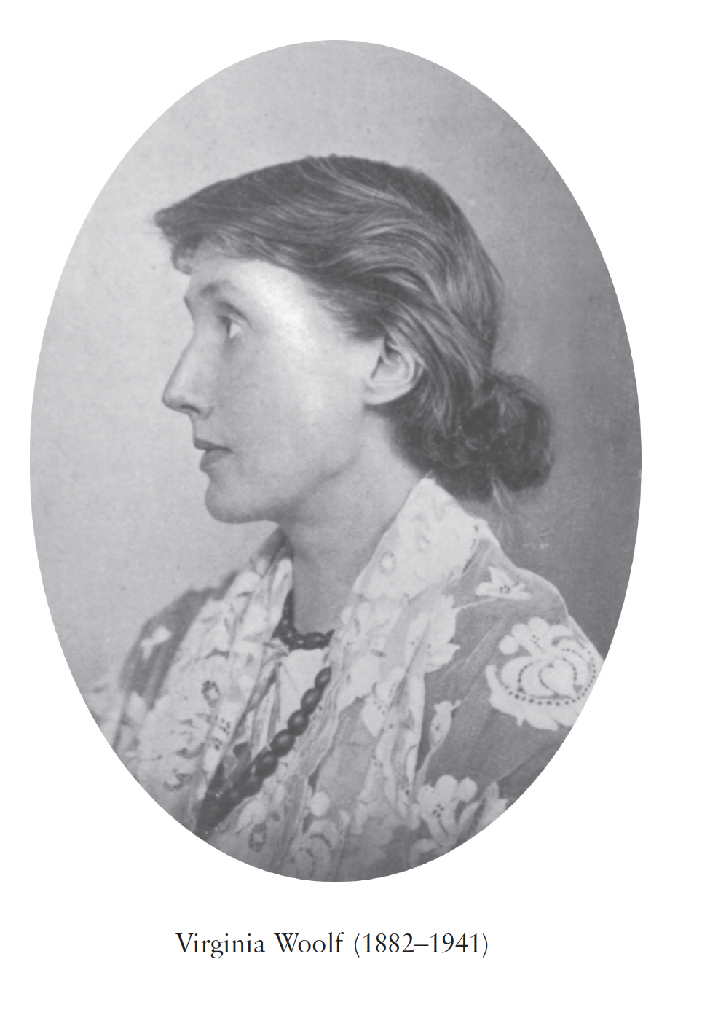
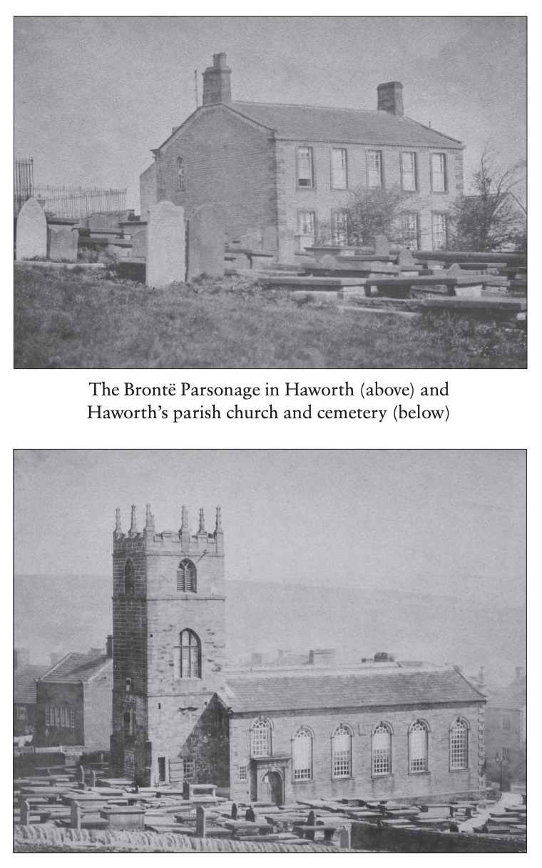
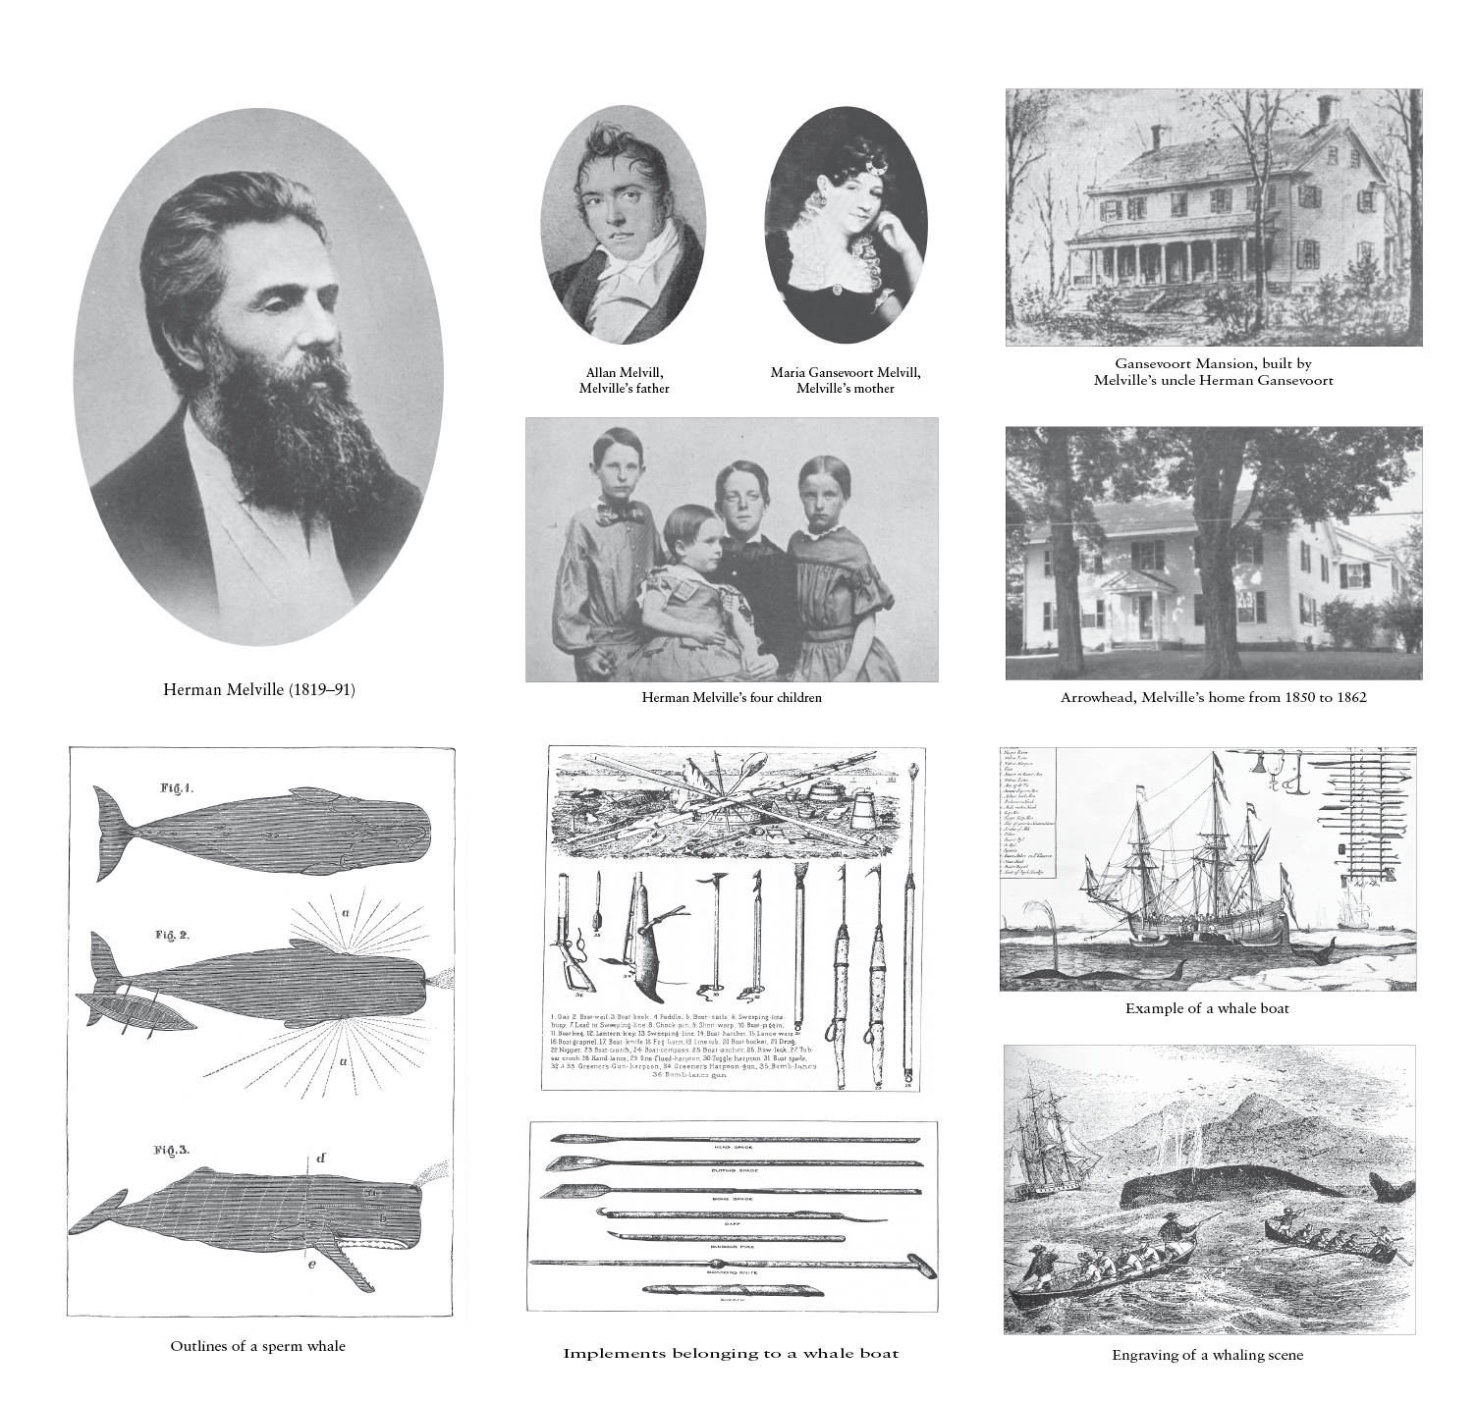
ABOUT THE SERIES: Alma Classics Evergreens is a series of popular classics. All the titles in the series are provided with:
ILLUSTRATIONS:
Eight plates with pictures, photos and drawings which brings the past to life for the modern reader. Images of people, places, manuscripts and more give a unique visual insight into the world in which the book was written.
ATHOR’S LIFE
A section concentrating on the personal and historical circumstances that shaped the author’s work.
AUTHOR’S LITERARY CAREER
A list of the author’s works in chronological order, accompanied by brief descriptions and commentaries, with in-depth accounts of the major works and the title in question.
TEXT AND TRANSLATOR’S NOTES
A short textual note and, if relevant, a brief translation note and translator’s biography.
BIBLIOGRAPHY
A list of bibliographical resources to guide further reading.
ESSENTIAL NOTES
These will provide important contextual detail relevant to the work
APPENDICES
Further reading material, such as relevant letters, documents or works by the author.
EVERGREENS
Over 100 titles

Slide 3
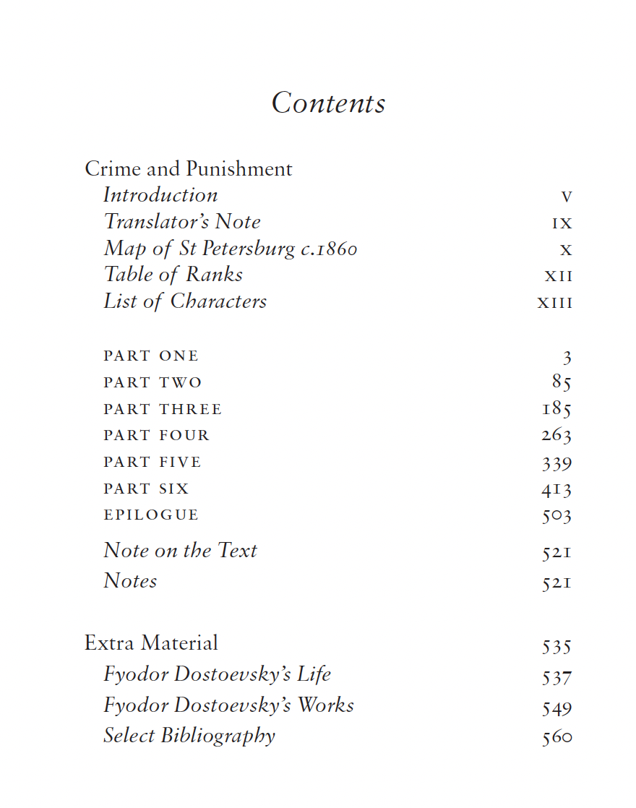
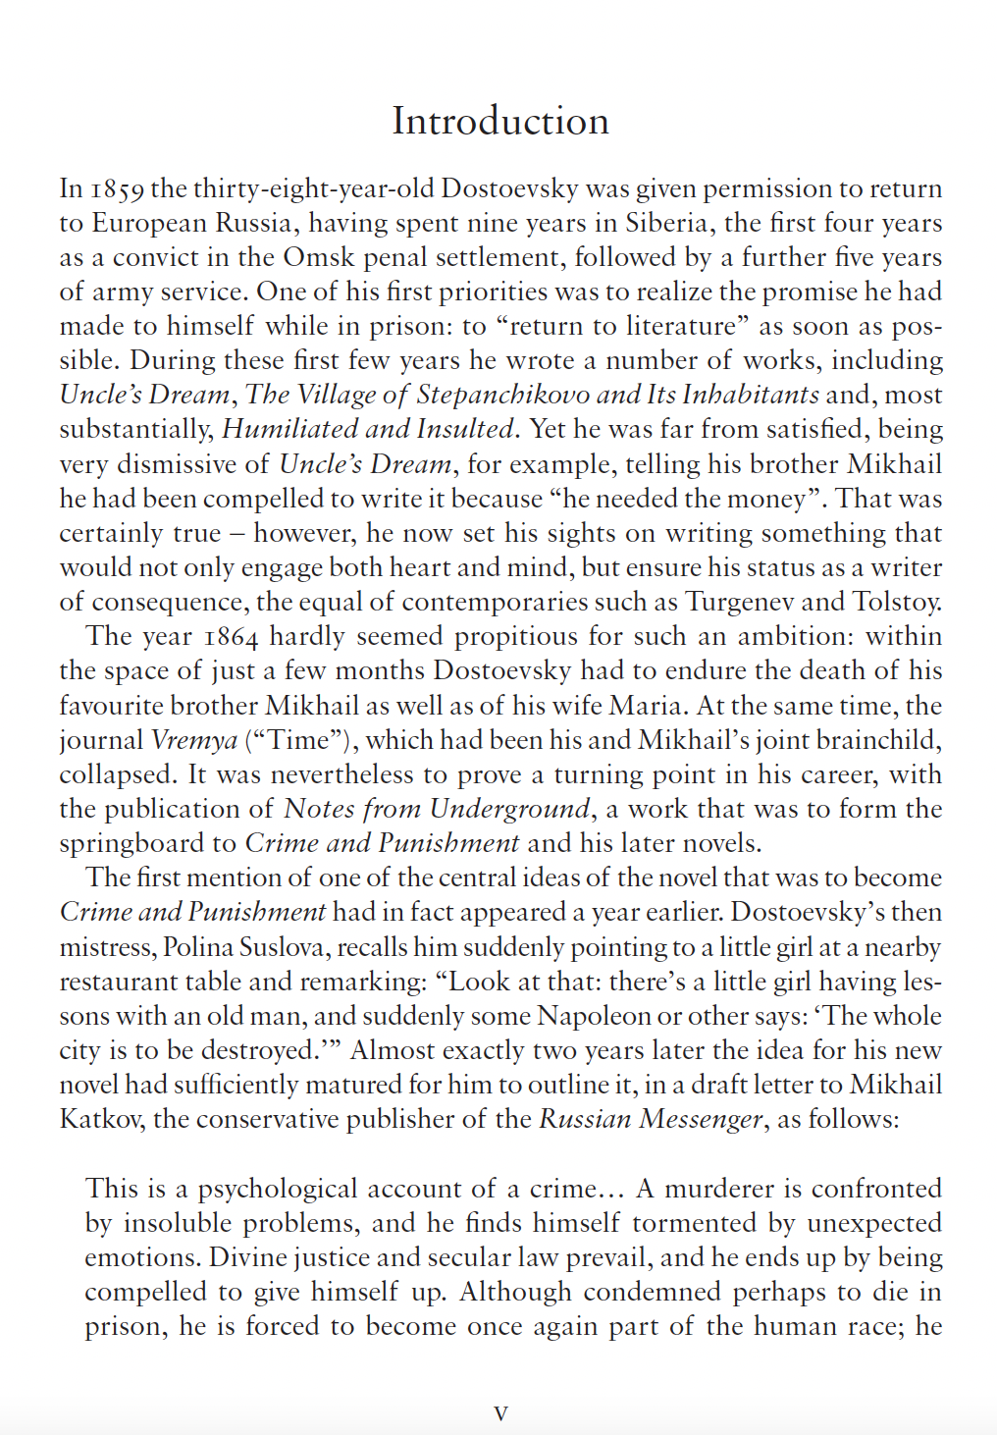
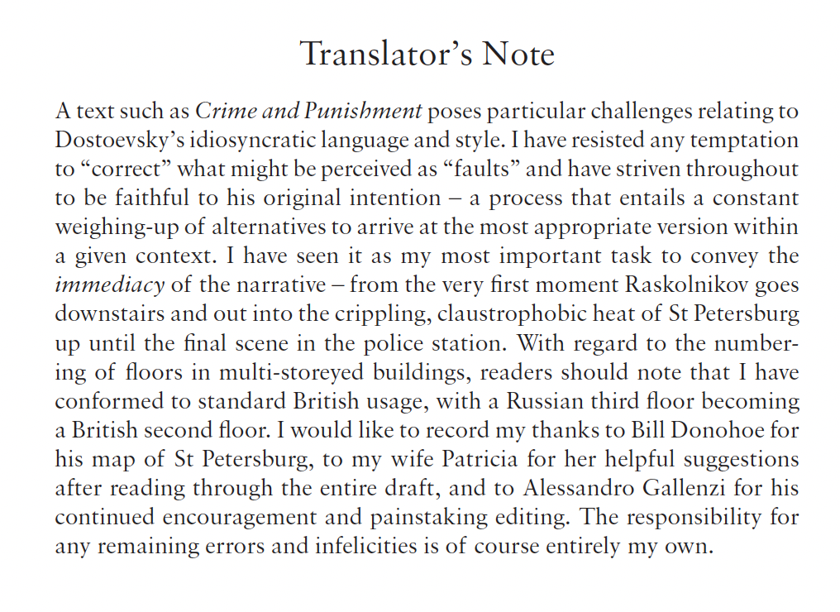
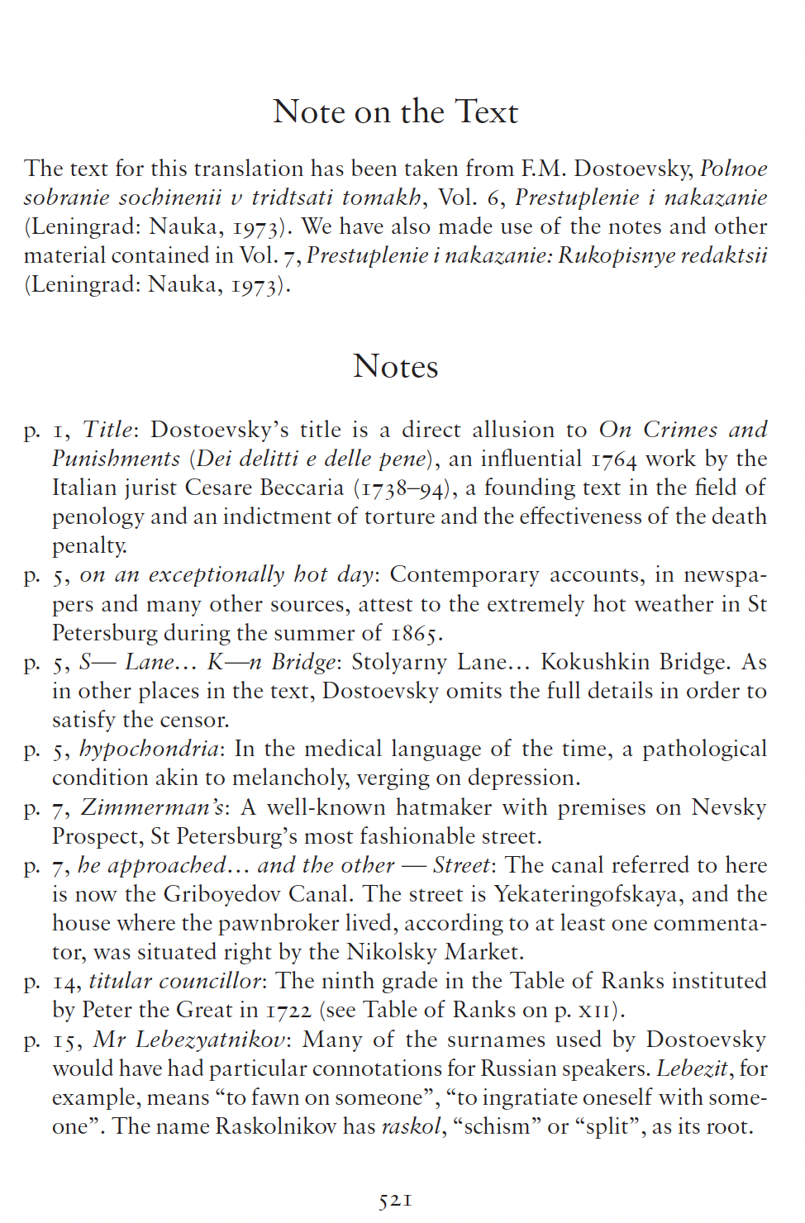
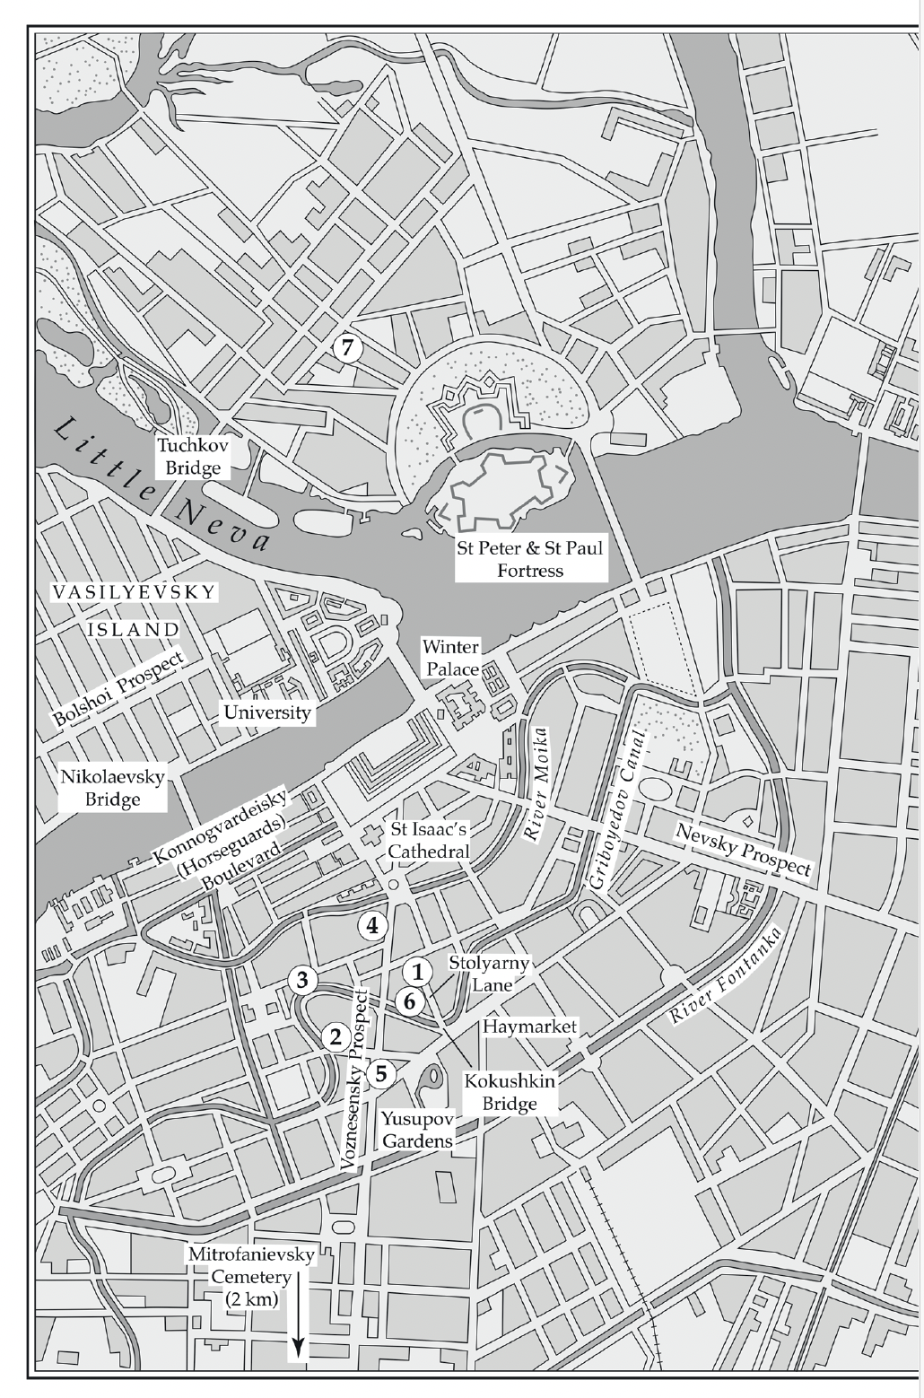
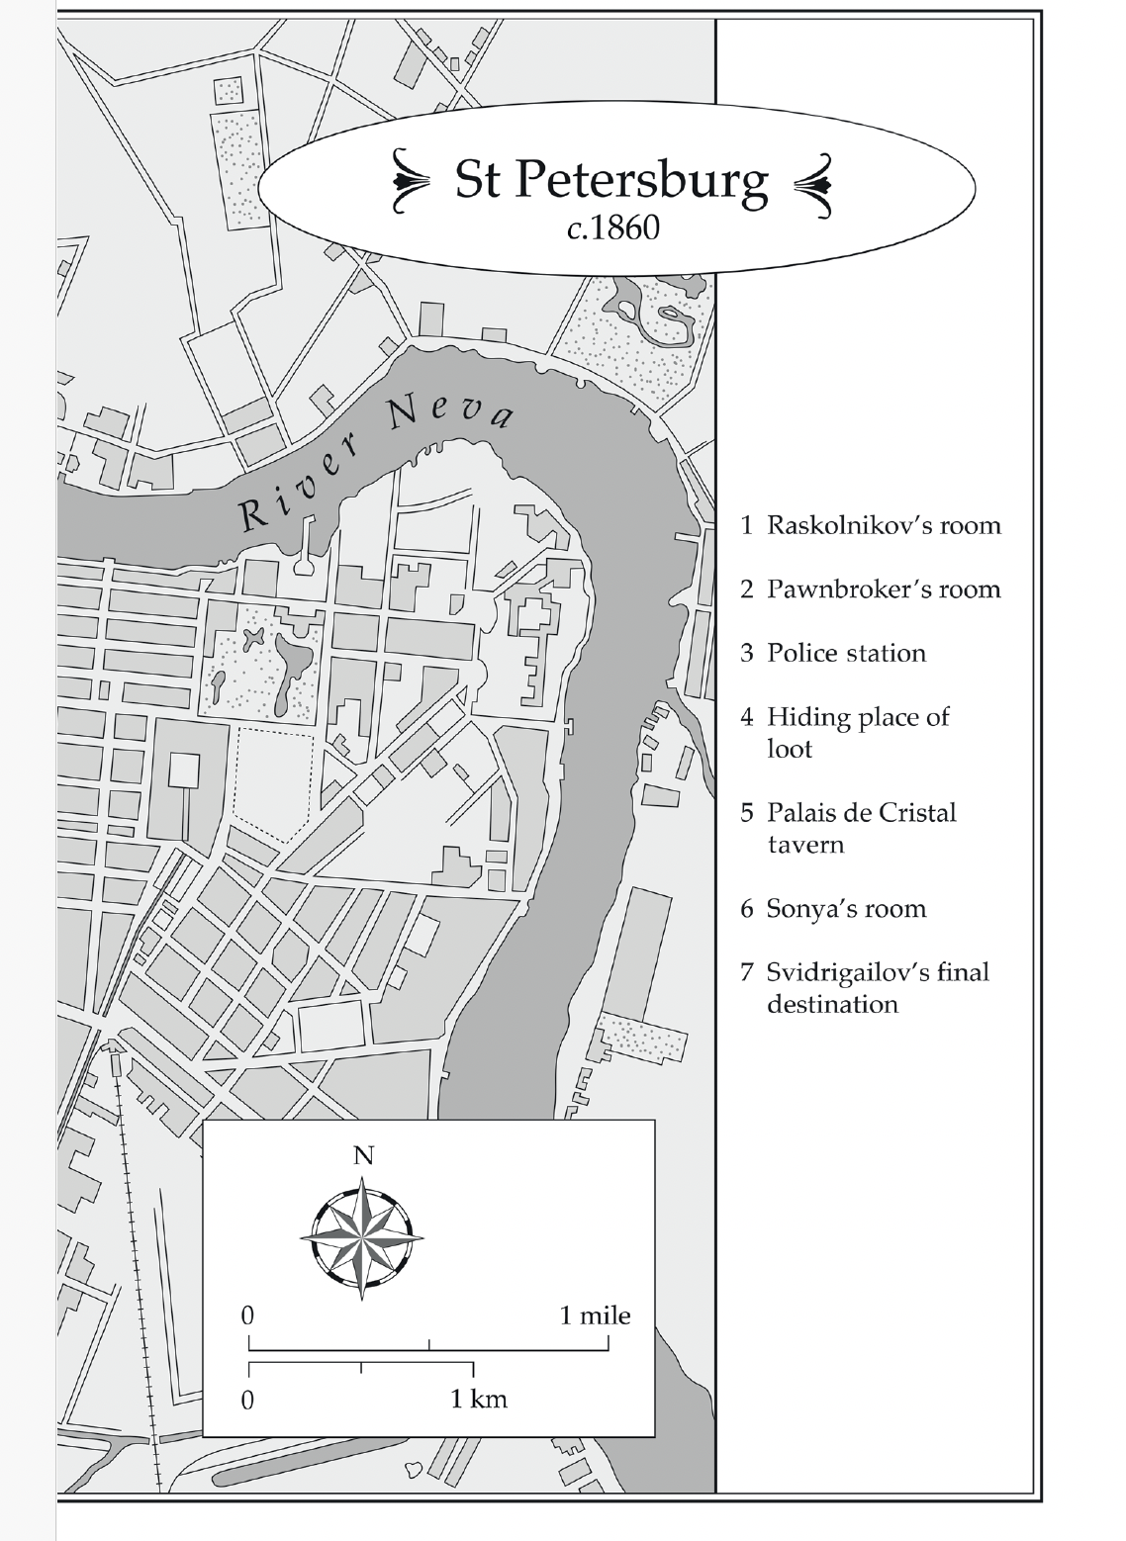
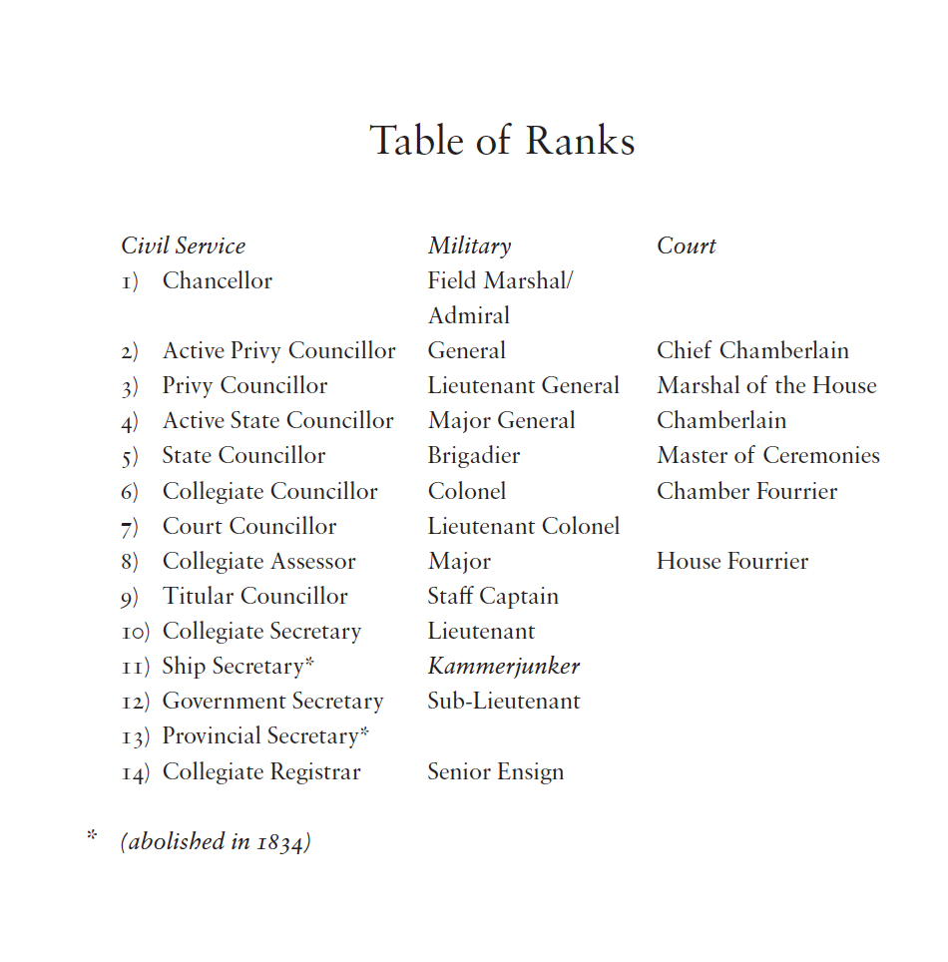
SAMPLE PAGES FROM CRIME AND PUNISHMENT BY FYODOR DOSTOEVSKY

Slide 4



War and peace
New Classic – APRIL 2027
By leo tolstoy
NEW TRANSLATION by
STEPHEN pimenoff
Deluxe hardback edition
Fully Annotated
SERIES: Alma Classics
22nd April 2027
£25
9781847499530
Demi Hardback
1200 pp
Subject: FBC, FYT
Rights: World English
Printed straight onto the hardback boards
using foil blocked case
sprayed edges, printed endpapers and ribbon
ISBN 978-1-84749-826-7
PAPERBACK – 288 pp.
£5.99

Slide 5

WAR AND PEACE
New EVERGREENS – april 2027
By LEO TOLSTOY
New translation by Stephen Pimenoff
• Fully annotated edition of a timeless classic
• Presented in a sparkling new translation by Stephen Pimenoff
• The last volume in Alma Tolstoy Collection
SERIES: Alma Classics
Evergreens
22nd April 2027
£12.99
9781847499509
1200 pp • PB
Subject: FBC, FYT
Rights: World English
ISBN 978-1-84749-826-7
PAPERBACK – 288 pp.
£5.99

Slide 6

Anna Karenina
9781847493682 £7.99
A Calendar of Wisdom
9781847495631 £8.99
Childhood, Boyhood, Youth
9781847496003 £8.99
The Death of Ivan Ilyich and The Devil
9781847493637 £8.99
The Forged Coupon
9781847496676 £8.99
Hadji Murat
9781847494818 £8.99
The Kreutzer Sonata and Other Stories
9781847494115 £8.99
Three Novellas:
The Devil, Family Happiness and A Landowner’s Morning
9781847494795 £8.99
All books are presented in new translations
Contain notes and extra material
The most complete collection of works by Leo Tolstoy on the market

Slide 7

Torrents of spring
New alma classics – may 2027
By Ivan turgenev
New translation by Michael Pursglove
• Fully annotated edition
• Presented in a sparkling new translation
• The last volume in Alma Turgenev Collection
SERIES: Alma Classics
26th May 2027
£9.99
9781847499462
288 pp • PB
Subject: FBC, FYT
Rights: World English
ISBN 978-1-84749-826-7
PAPERBACK – 288 pp.
£5.99

Slide 8

A Nest of the Gentry
9781847495907 £8.99
Fathers and Children
9781847494894 £7.99
Faust
9781847492180 £9.99
Memoirs of a Hunter
9781847499042 £9.99
On the Eve
9781847496324 £8.99
Hadji Murat
9781847494818 £8.99
Parasha and Other Poems
9781847498915 £8.99
Rudin
9781847492265 £8.99
Smoke
9781847493163 £8.99
The Diary of a Superfluous Man and Other Novellas
9781847497628 £8.99
Virgin Soil
9781847493750 £8.99
All books are presented in new translations
Contain notes and extra material
The most complete collection of works by Ivan Turgenev on the market

Slide 9




villette
New evergreens – june 2027
CHARLOTTE BRONTË
• New annotated edition of Villette by Charlotte Brontë
• Contains notes, a bibliography and extra material
• Perfect companion volume to Jane Eyre 9781847493736, The Green Dwarf and Other Early Fiction 9781847497611 and The Professor 9781847497178
24th June 2027
£9.99
9781847499431
500 pp • PB
Subject: FBC, FXD
Rights: World English
ISBN 978-1-84749-825-0
PAPERBACK – 224 pp.
£5.99

Slide 10

Now in Paperback
ACROSS SICILY GARIBALDI’S THOUSAND
By TIM PARKS
• A delightful account in Garibaldi's footsteps
• A voyage through the thrilling history of the expedition of the thousand which led to the unification of Italy in 1860
• Written by one of the most accomplished British writers
• Publicity and author’s events around publication
‘Parks has done Garibaldi and his Redshirts proud in this eccentric hosannah to the travails of walking in the Sicilian uplands.’
Ian Thomson, THE SPECTATOR
‘The many diaries written by those who accompanied Garibaldi are Ti
‘There’s an admirable stubbornness also in the writer’s quiet demand for answers about the authentic relationship between present and past in Italy. A feeling that serene indifference isn’t enough lends distinction to this book.’
Jonathan Keates, LITERARY REVIEW
SERIES: Alma Books / Non-fiction
26th May 2027
£12.99
9781846884771
320 pp • Paperback
Subject: WTL, 3MNQ-IT-N
Rights: World English
ISBN 978-1-84749-828-1
PAPERBACK – 224 pp.
£5.99

Slide 11

GREAT LOVE STORIES IN ALMA CLASSICS

Slide 12

EVERGREENS
FORTHCOMING TITLES July to Dec 2022

Slide 13

















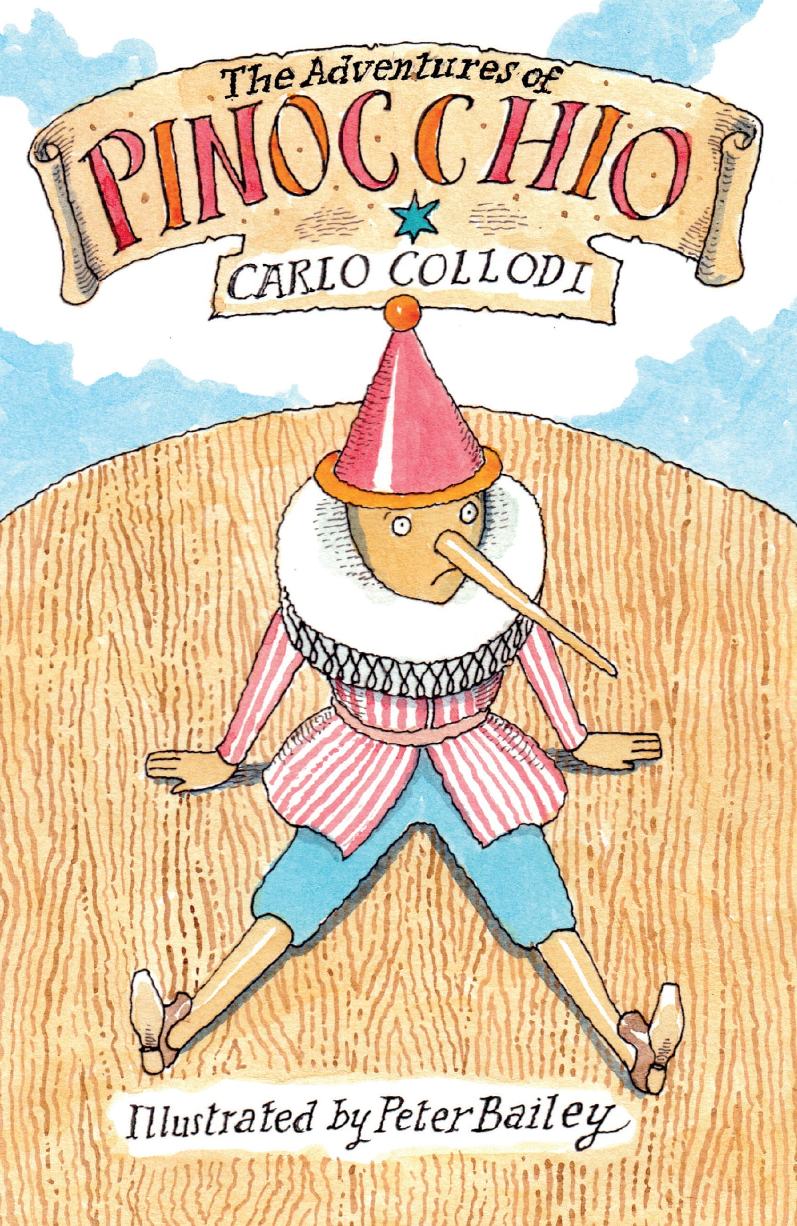



• All our children’s classics have beautiful drawings by renowned illustrators
• Each volume contains extra material for young readers, including:
a profile of the author
a section about the book
a list of characters
a glossary
a test-yourself quiz
ALMA JUNIOR TOP 20
EVERGREENS
FORTHCOMING TITLES July to Dec 2022

Slide 14





















• All our classics offer students the definitive text and extensive notes
• All our editions contain detailed and
comprehensive extra material about the author’s life and works
• Each volume contains a carefully selected bibliography
• Accurate translations
• All our books are presented in beautiful paperback editions and are accessibly priced
ALMA CLASSICS TOP 20

Slide 15


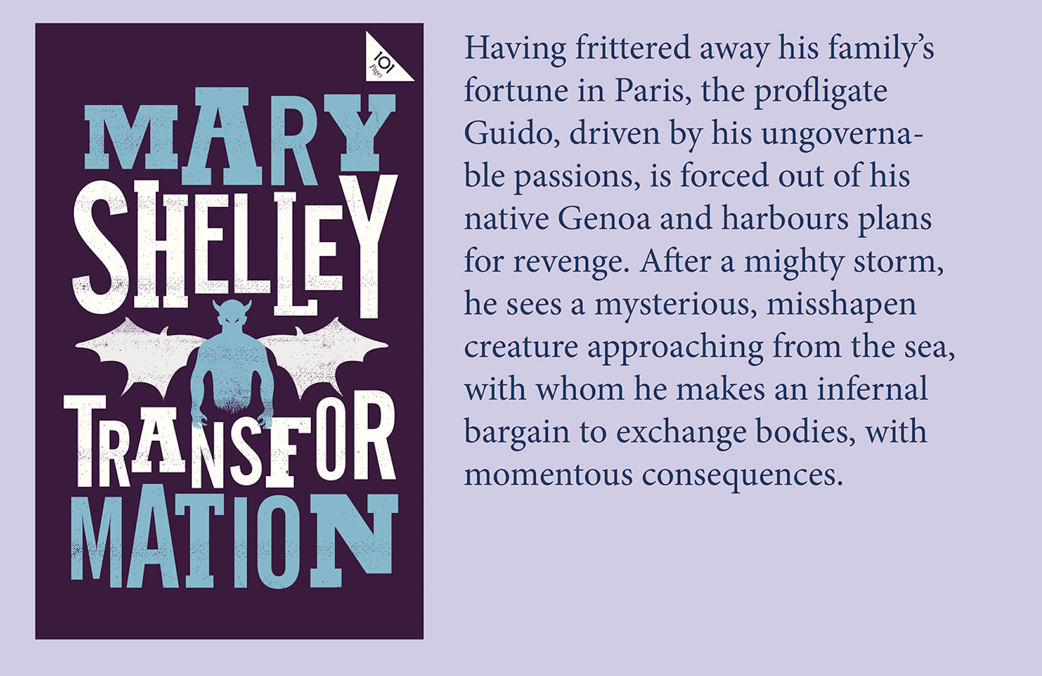


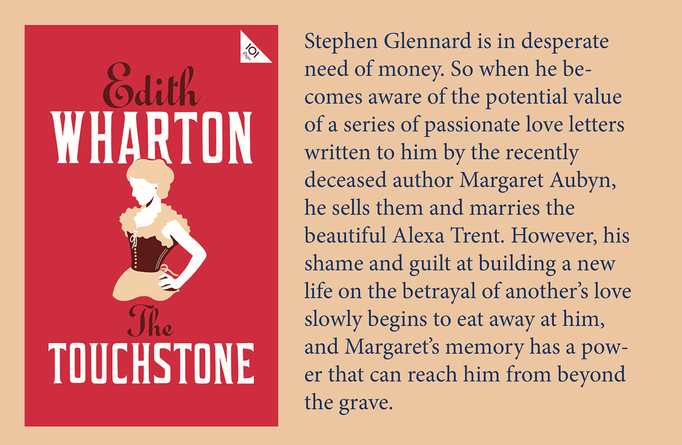

Slide 16
